Slide 1
StayMatch
Prathima S R (Project Manager) Kritika Agarwal (Lead Developer) Akshat (Jenkins Admin) Rahul Mendes (Lead BA) Daulet (Product Owner)
Shubham (DBA)
Kritika (Jira Admin) Daulet (Lead QA)

Slide 2
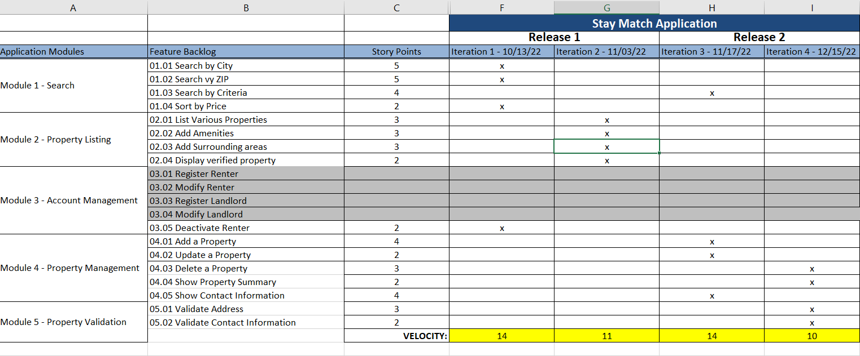
Road Map
(Prathima Seethalam Radhakrishna)

Slide 3
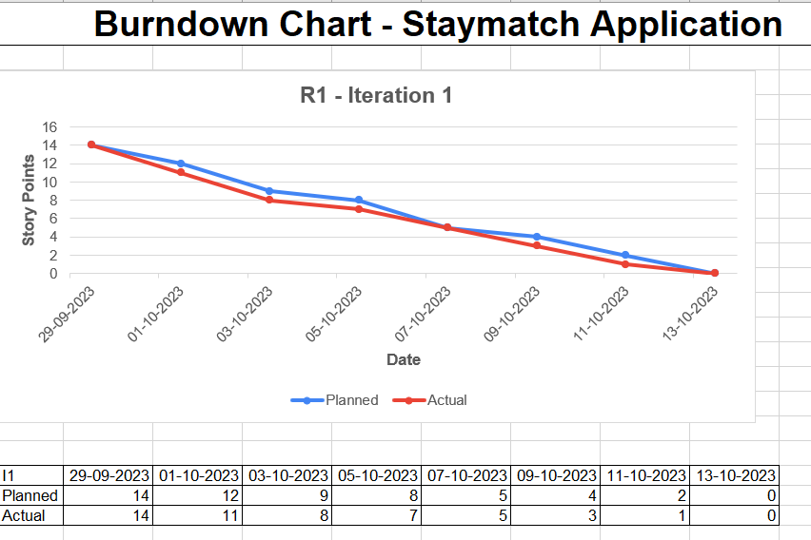
Burn Down Chart
(Kritika Agrawal)

Slide 4
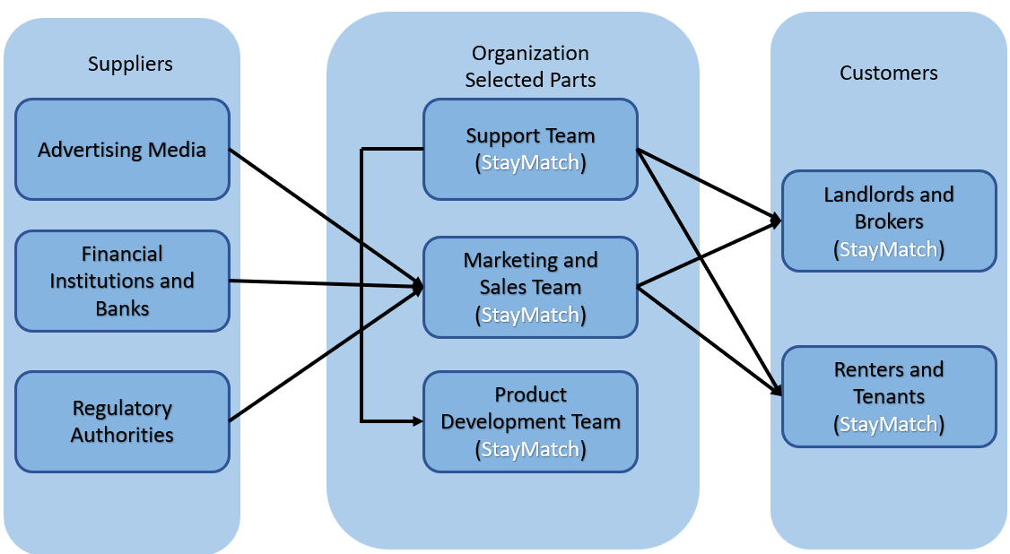
BRM Diagram (Shubham Mishra)
Suppliers
Organization selected parts
Customers

Slide 5
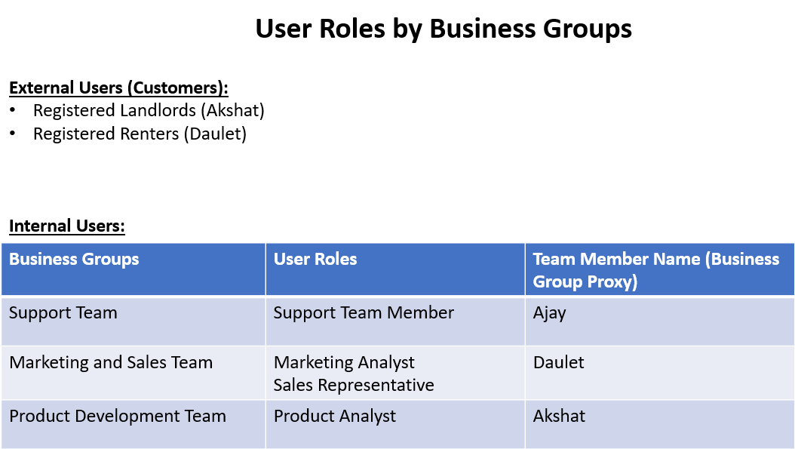

Slide 6
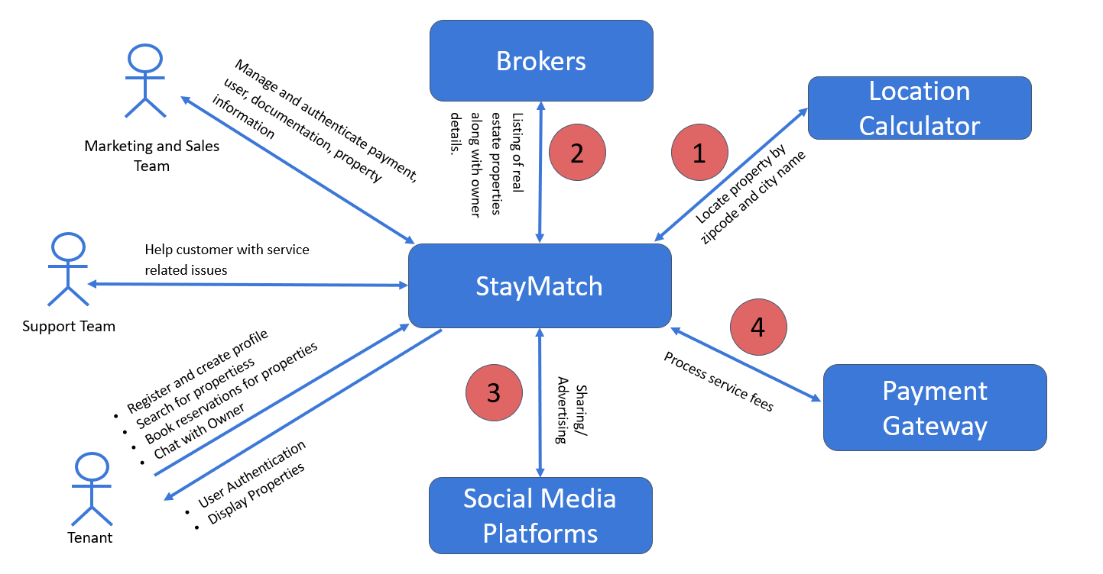
Context Diagram
(Shubham Mishra)

Slide 7
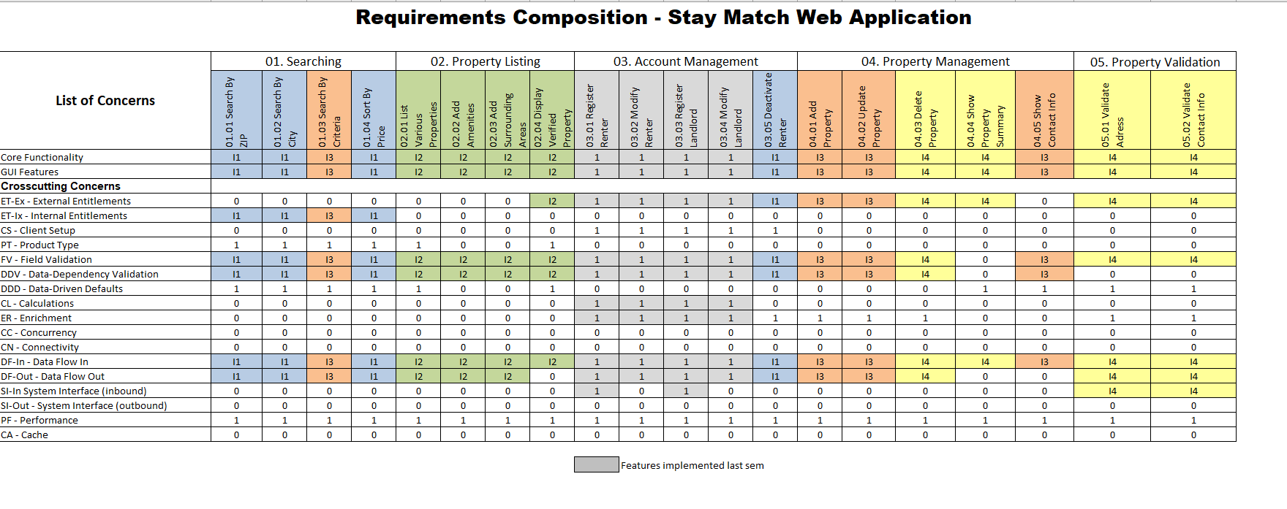
RCT Planning view
(Rahul Mendes)

Slide 8
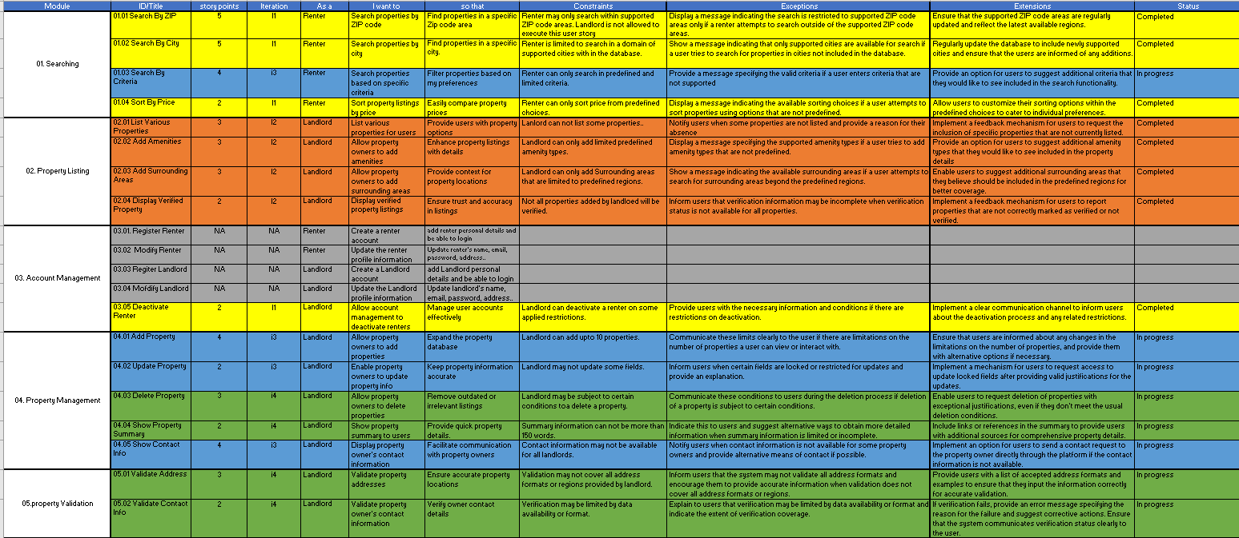
User Stories
(Ajay Kumar)

Slide 9
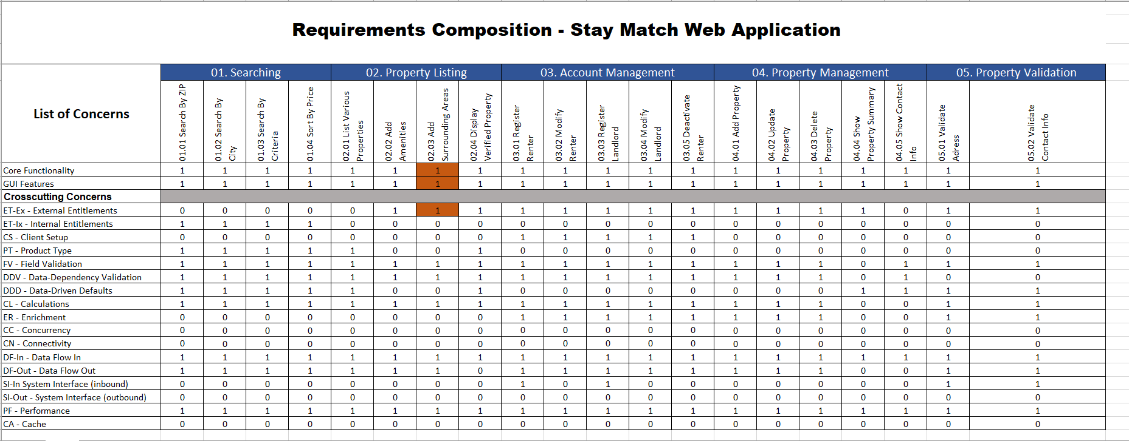
Acceptance Test
(Dhruv Chamaria)

Slide 10
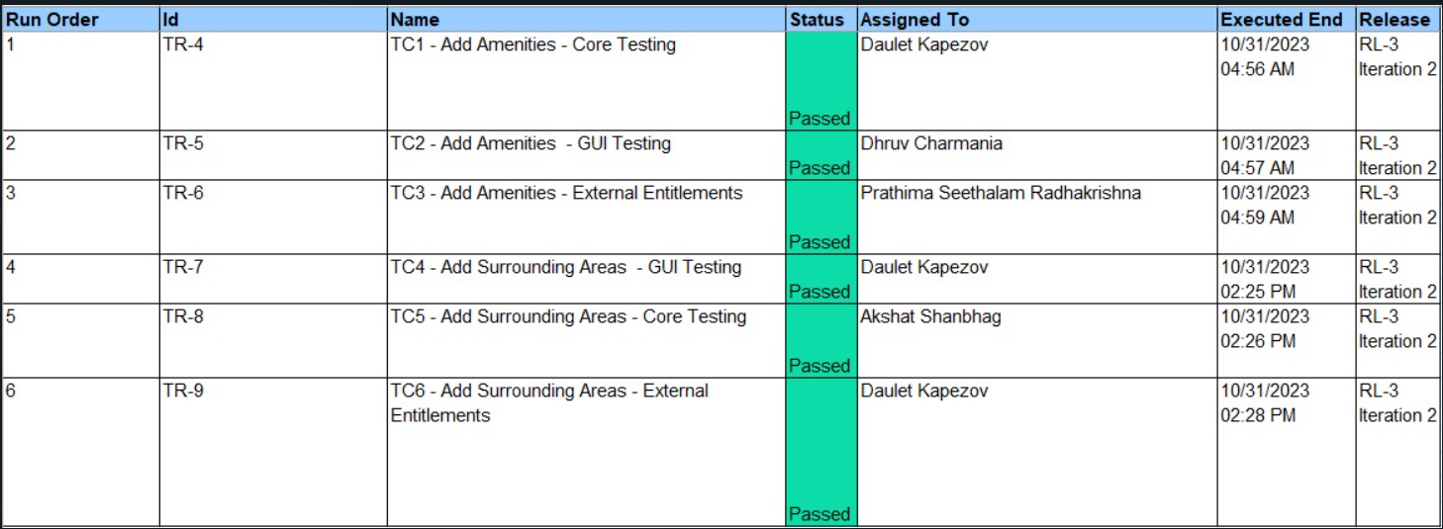
Test execution Log
(Daulet Kapezov)

Slide 11
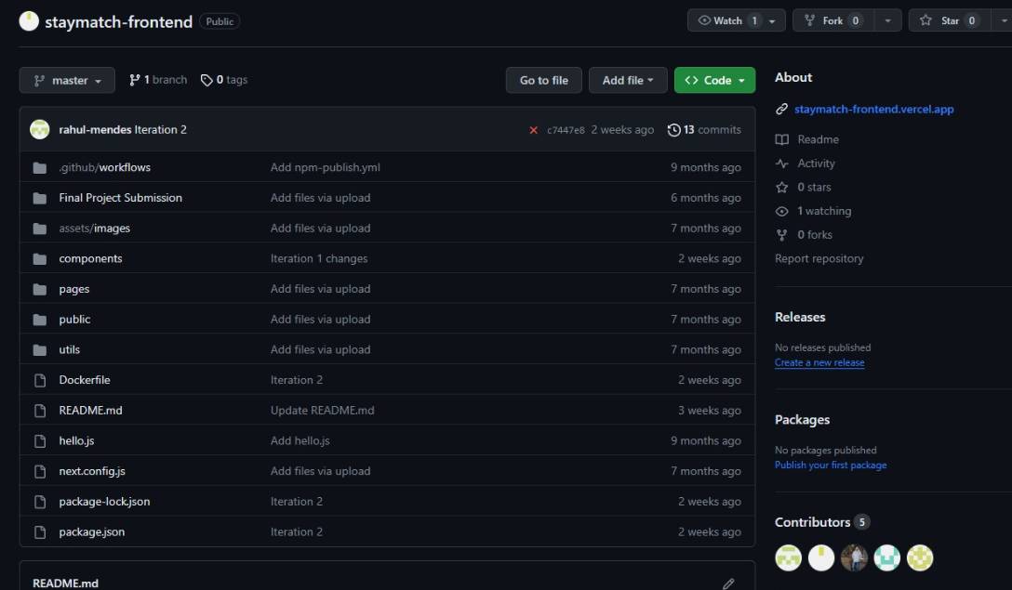
Git Hub Folder
(Ajay Kumar)

Slide 12
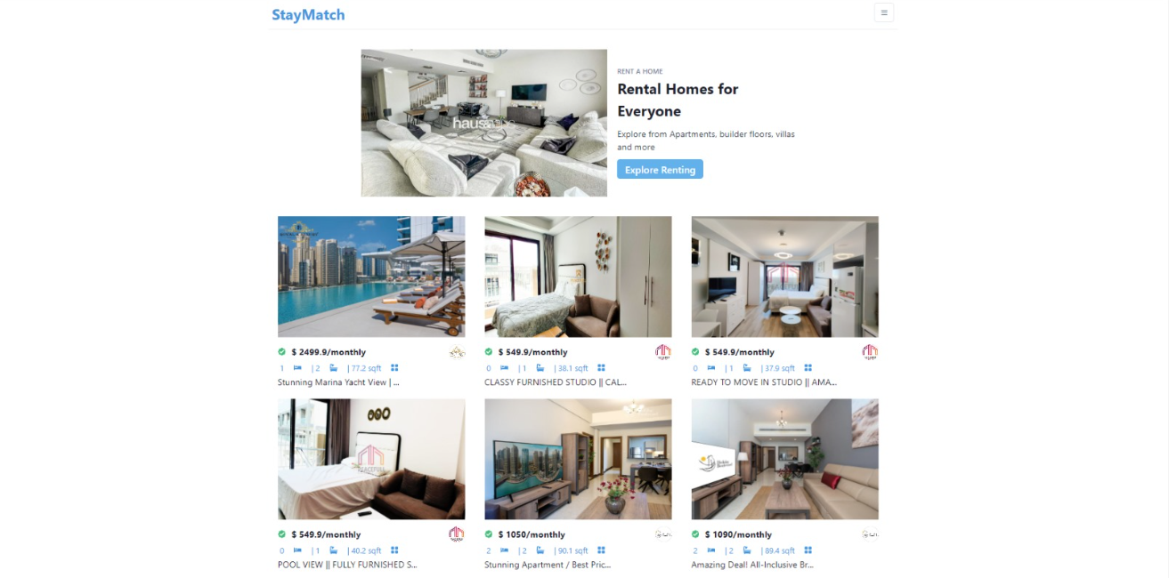
Recorded Demo
(Prathima Seethalam Radhakrishna)

Slide 13
Thank You

